Slide 1
Substance 3D Automation
3D Automation SaaS Offerings for Enterprise
Polly Ing | Head of Product, Web & Cloud
Olasile Abolade | Sr Product Manager, Web & Cloud
Primary Collaborators: Landon Giss, Morgan Gurfinkel, Vijaj Vachani, Carly Abbott, Warren Langevin, Eric Engleman, Sayash Kumar, Erica Rutledge, Matthew Purdon.

Slide 2
Creative Cloud Automation Services (CCAS)
Creatives Are Not Robots: Letting APIs and Automation Do That for You. Join the creativity transformation with Adobe Creative Cloud Automation Services

Slide 3


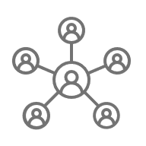




Enterprises’ need for content is exploding
Number of supported channels, markets, and formats is exploding
Creative teams, tools and workflows are siloed and fragmented
Growing needs from brands for dynamic content and optimization
Budgets & resources not increasing relative to content volume needed
Customers expect more and more personalized experiences
Need to scale and stitch across changing teams & environments

Slide 4
API Automation accelerates customer creative velocity
74% of creative professionals spend over 50% of their time on repetitive, non-creative tasks and creative teams spend less than 30% of their time on creative processes.
Asset automation is all about automates time-consuming and repetitive tasks to enable content production and delivery velocity at scale.

Slide 5
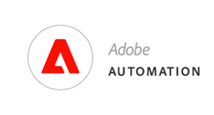
Maximizing production capacity of enterprise teams
The production team needs to be empowered to use their time efficiently, focusing on making creative decisions rather than manual, repetitive tasks
1135¹
141%
3.5x – 5x
Hours of Production and Rendering Cost Saved
Increase in Production Capacity
Reduction in Content Production Errors
"The implementation of Adobe Creative Cloud Automation Services has revolutionized our creative process. We have significantly reduced the time spent on repetitive tasks, allowing our team to focus on innovation and high-quality content creation. The seamless integration with our existing tools has been a game-changer, enhancing our productivity and overall efficiency. We couldn't be happier with the results!“
Susan McPherson, Creative Director at Allegiant Studios
"Using the 3D Cloud Automation Service has been a transformative experience for our company. The API automation features have streamlined our workflow, cutting down production times and reducing errors. The flexibility and scalability of the service have enabled us to take on more complex projects with confidence. Adobe's solution has truly empowered us to push the boundaries of what we can achieve creatively.“
Henry Muzotti, Head of Digital Production at Hersheys
1. Number reported on internal product metrics on Adobe Substance 3D Automation Service as of June 2023

Slide 6



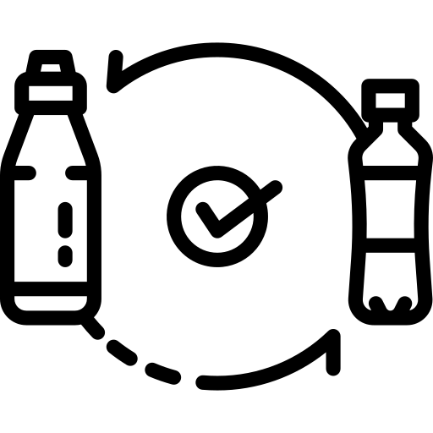

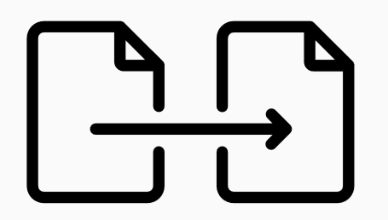





Our Solution: Creative Cloud Automation Services
Our Creative Cloud for enterprise APIs scale generation of asset variations across segments, channels and geos, leveraging AI to maximize quality, and suggest new assets based on performance
SAMPLE APPS & SERVICES
Replace smart object
Modify layers/text
Convert/Render
Presets
Autotone
Data Merge
Renditions
Batch Export
Photoshop Actions
SAMPLE USE CASES
Create personalized artwork using smart object replacement
Streamline image quality settings across thousands of images
Support variable data printing services

Slide 7
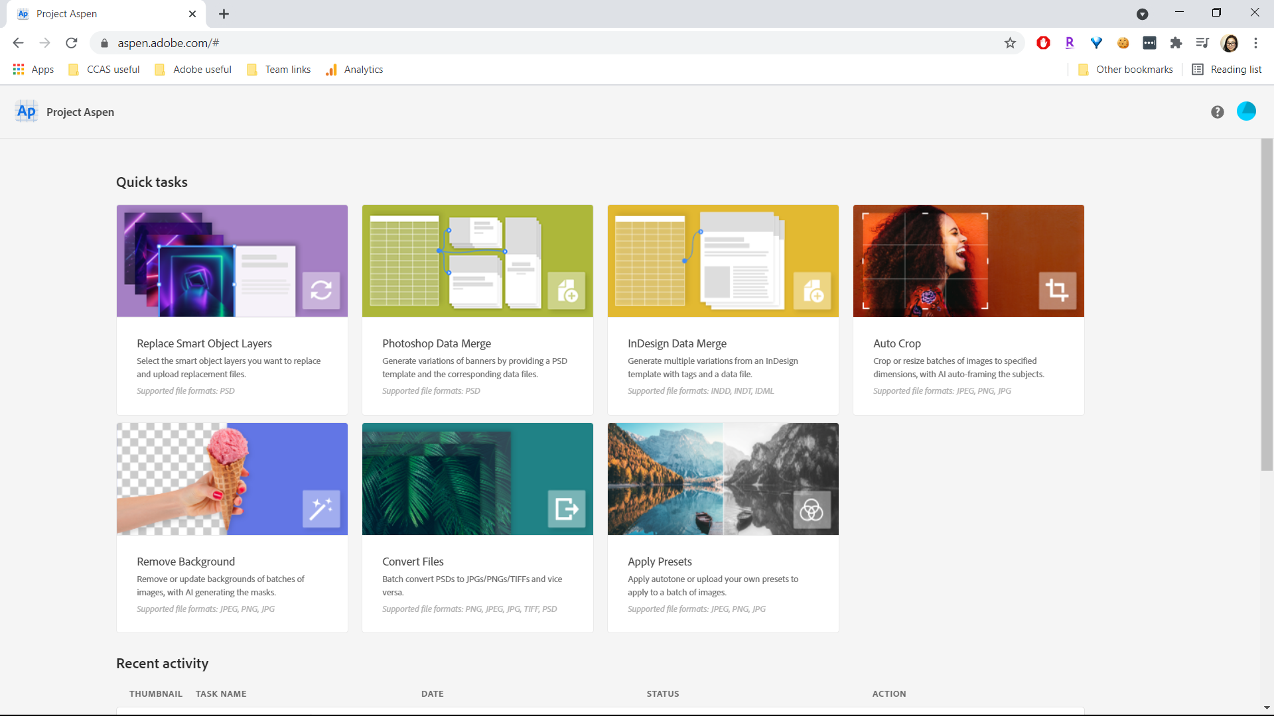
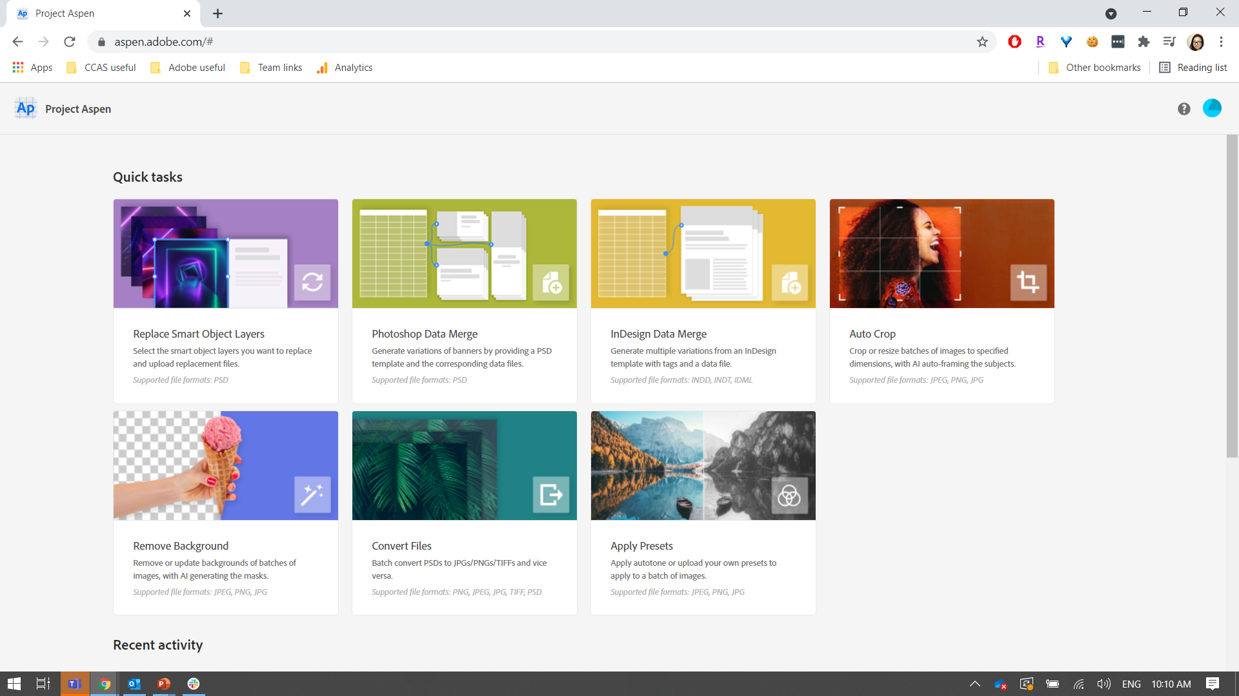


CCAS supports the following:
1. Cropping images for marketing channels.
2. Cutting out products or people.
Cropping images for different social media channels.
Resizing for different web dimensions.
Removing background from studio product shots.
Removing background from headshots and putting on branded background.
3. Variations of digital marketing collateral.
4. Variations of print collateral.
Personalizing content for different customers
Generating name badges, conference badges, business cards
Regionalizing flyers, brochures, posters
Personalizing content for different customers
Swapping out artwork to visualize different designs
Variations of banner ads

Slide 8
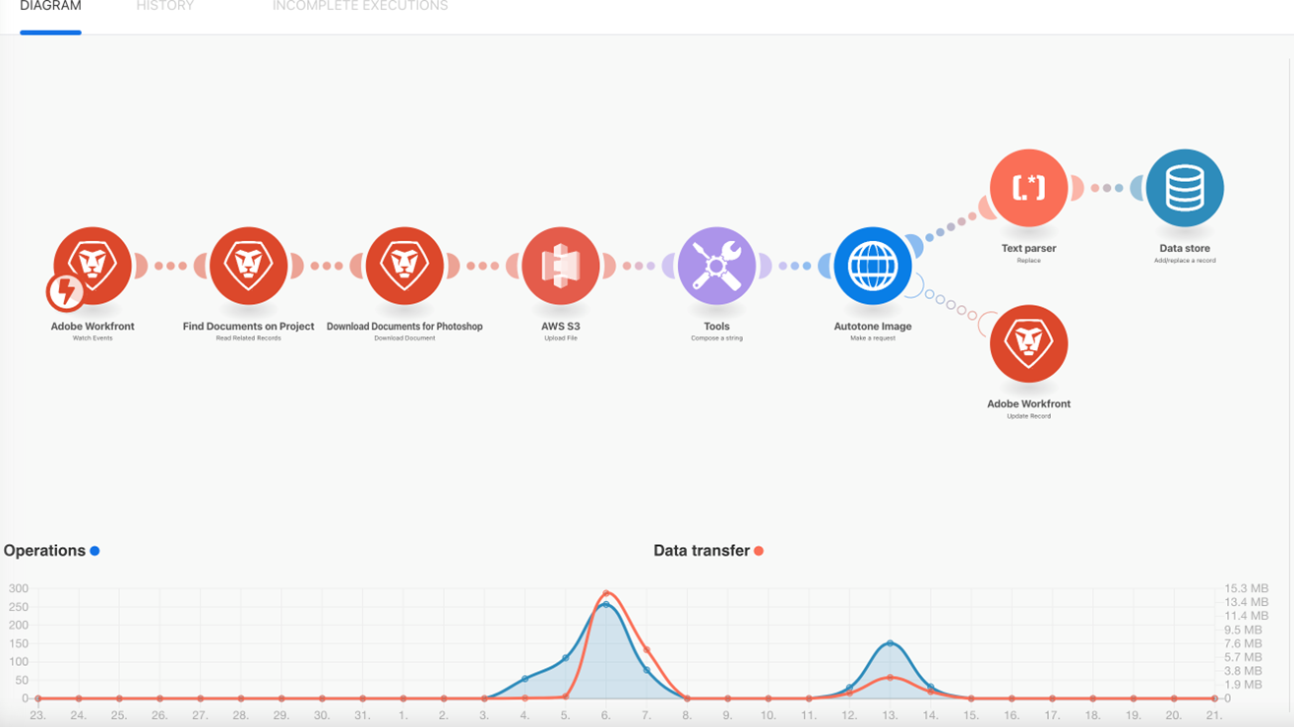
Integration and Workflow
Example: connecting an existing workflow with Photoshop API
Impact: Number of operational steps is reduced dramatically as automation eliminates many of the manual work saving time and resources

Slide 9
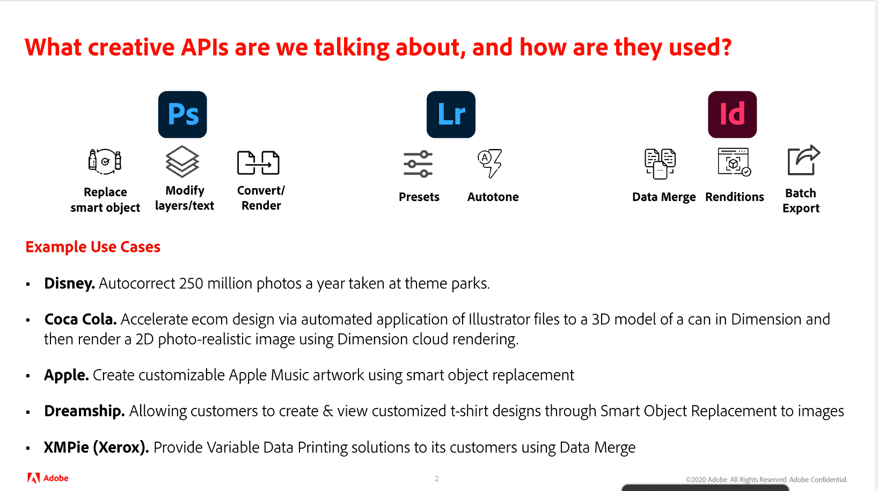
API Automation (examples)
CCAS supports video, audio, image, text and 3D content formats

Slide 10

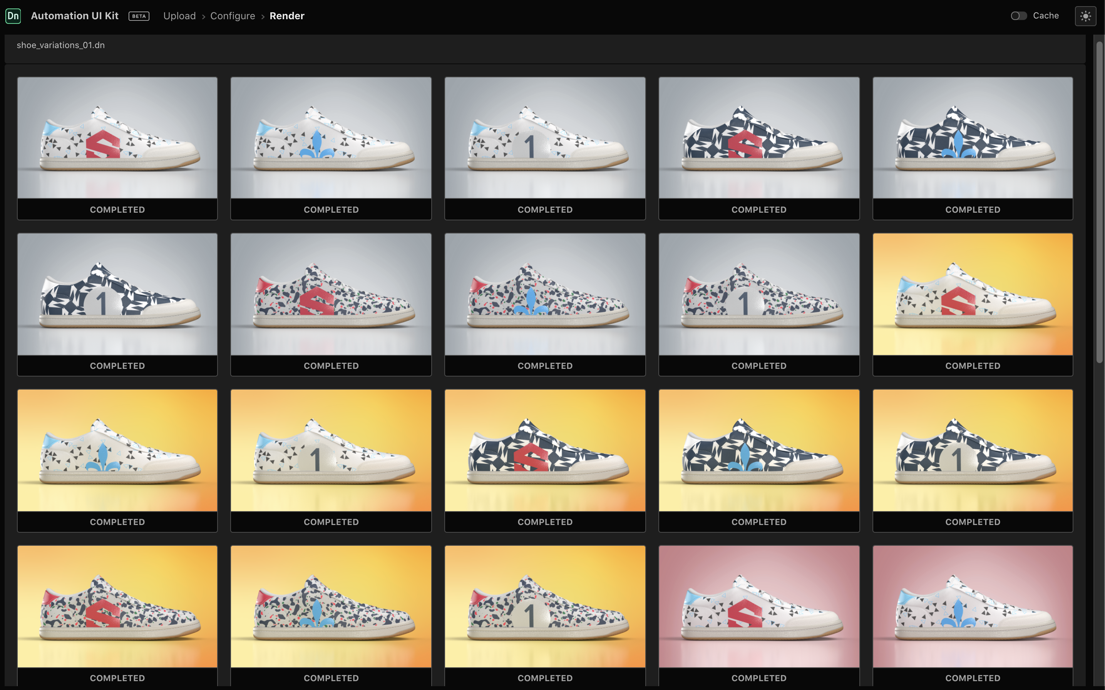
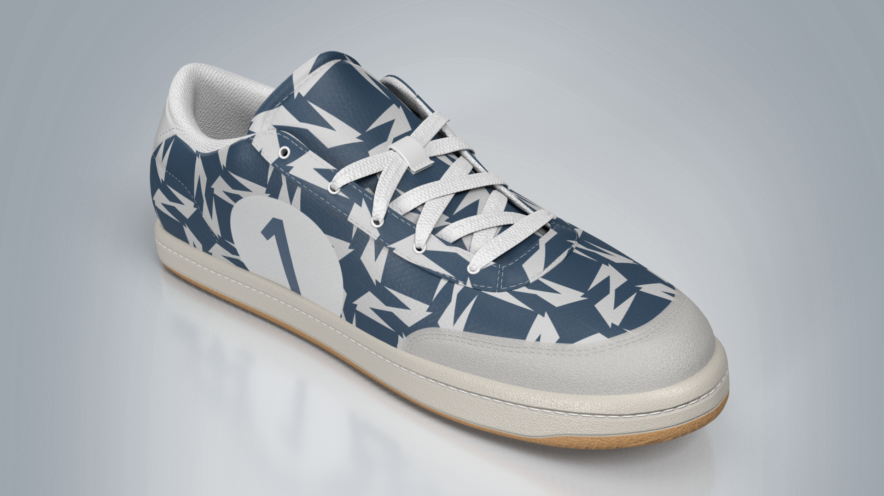
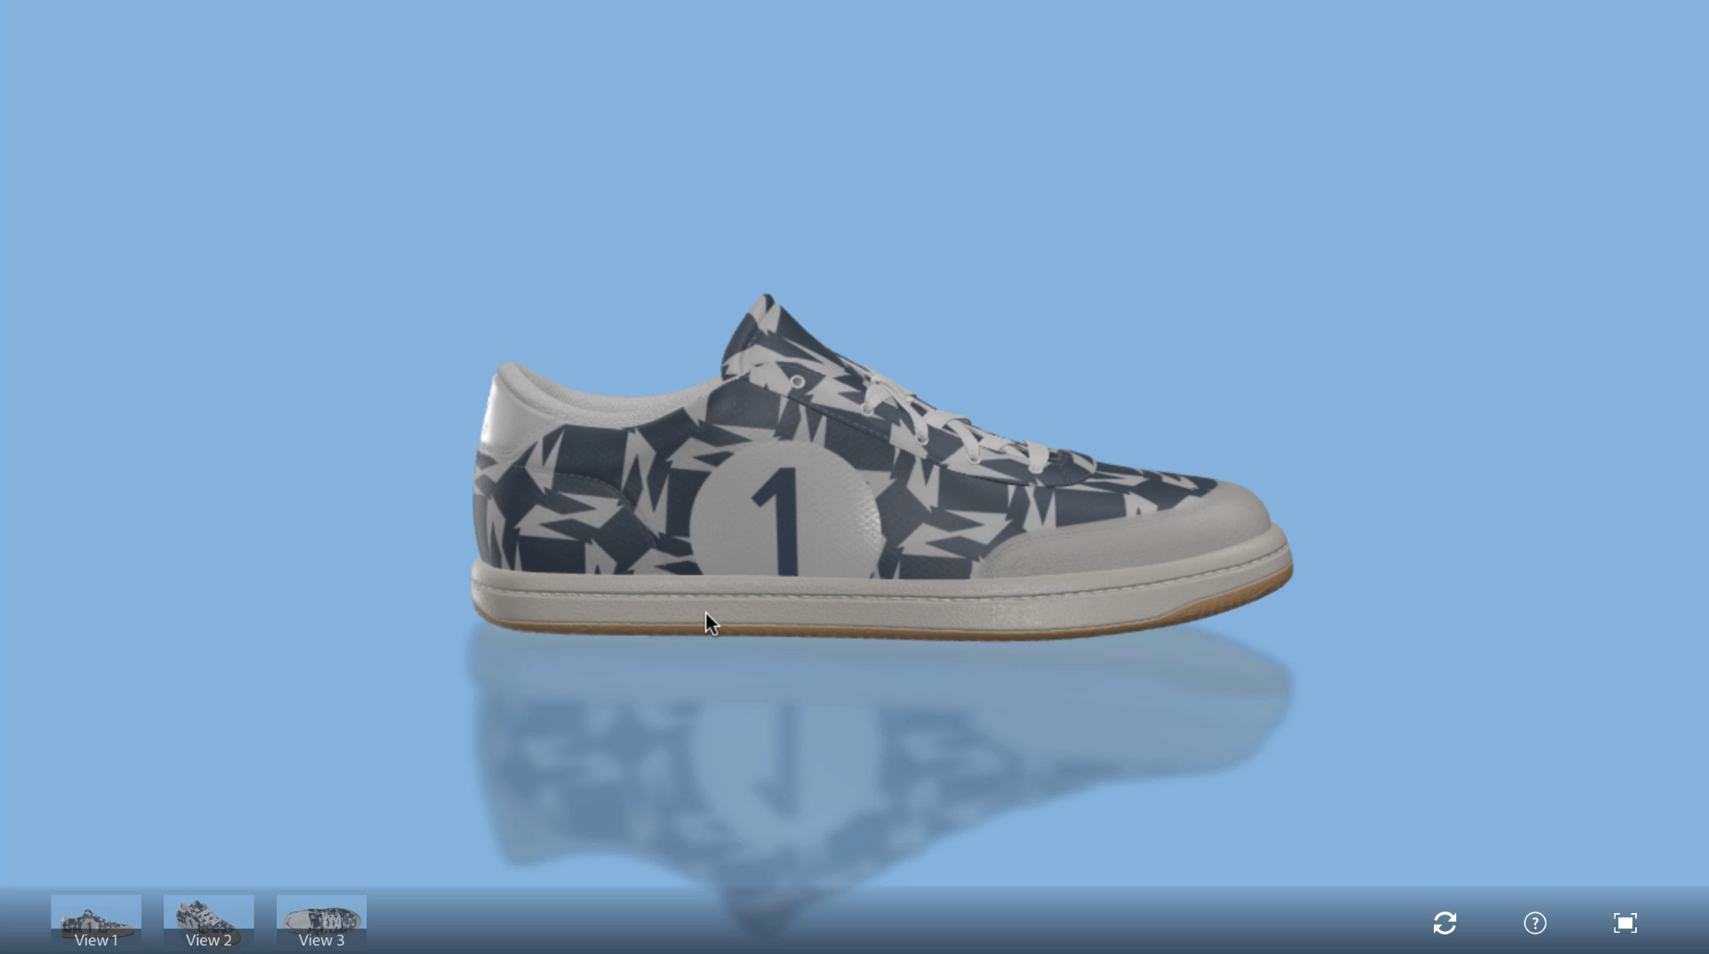
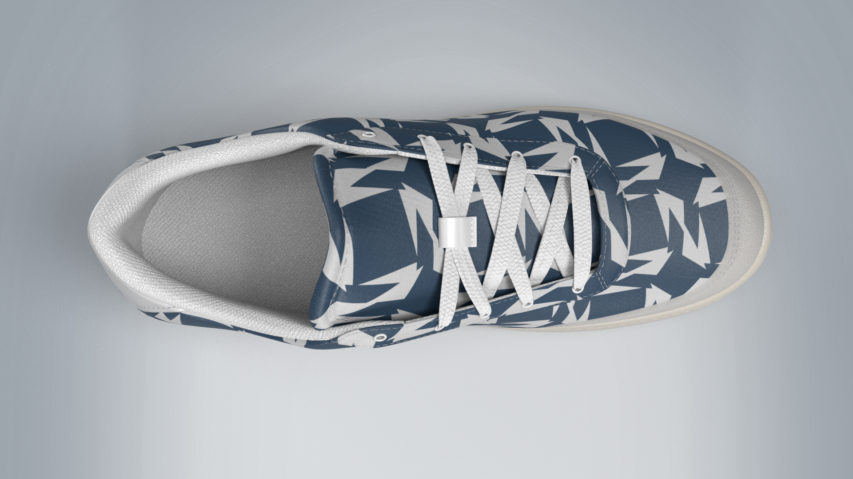
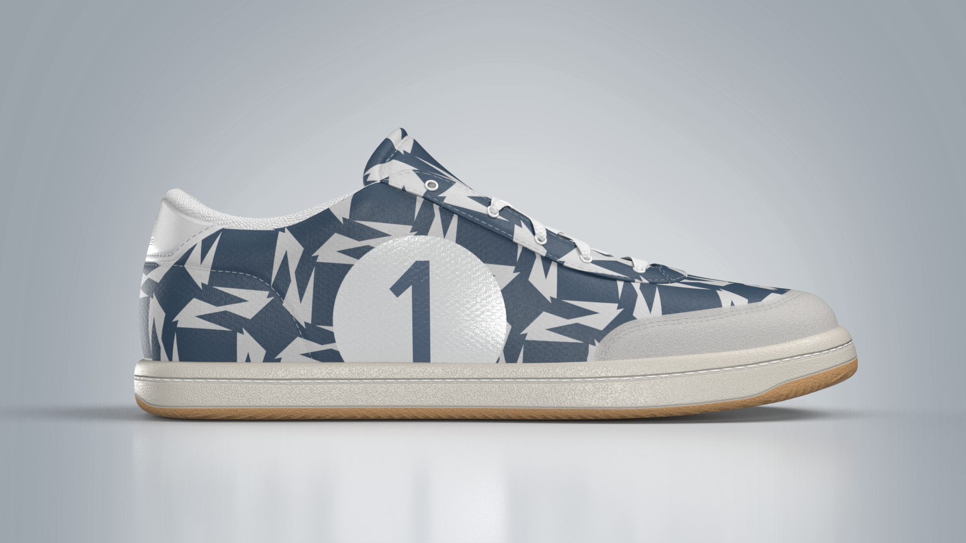
3DI Solution: 3D Cloud Automation Service (part of CCAS)
3D automation is virtual photography supercharged—eliminate manual work and generate marketing and E-commerce content at scale using your 3D assets and 2D inputs to generate 2D imagery variations and 3D file formats
2D product image variants
Export to 3D
Render camera angles

Slide 11
3D Cloud Automation Service
Built for Enterprise
Adobe Substance 3D Automation Service offers both a web application and a developer solution that enables enterprise companies to manage and run their 3D asset processing pipelines in the cloud leveraging the capabilities of 3D and virtual photography to accelerate content generation and deliver high quality product experience
Automation Web Application (For Product Design Teams and Creative Professionals)
Transform your existing 3D asset by making use of our intuitive web application to create multiple variations of a product at scale for your design and production needs
Intuitive and easy to use web interface
Pre-configured 3D asset and scene manipulations and operations
Reduce costs and environmental impact in your design and production workflow by leveraging virtual photography to ideate and iterate through your 3D creative process
Improve E-commerce and Marketing use cases by exporting your generated renders in web-ready formats
Adobe Content Platform for secure storage
Automation APIs (For Developers)
Integrate your 3D asset processing pipeline with the Substance 3D Automation Service via our robust RESTful automation APIs at no developmental and maintenance cost
Integration made easy with our robust APIs
Pre-configured 3D asset/scene manipulations and operations
All orchestration, dynamic scaling and management of jobs taken care for you in the cloud
All technology component upgrades are seamless
No development and maintenance cost
Adobe enterprise grade security and reliability

Slide 12

3D Automation Access Points
3D Automation Web App
Intuitive user interface to the service
Web Browser
3D Automation Service
Powered by Stager
REST API
Notes:
Broadly, 3DI currently has three automation products, Substance 3D Automation (includes the API and webapp) and Substance Automation Toolkit
These products currently target different personas and use-cases which we talk more about soon
Technically speaking, these products are different:
3D Automation Service and Web App are SaaS offerings running on Adobe’s cloud and accessible via a web browser or REST API
Internally, they are powered by the same code that run Stager
When we talked about giving you access to stager-api, this is what we were talking about
Since it is powered by Stager. It is capable of doing operations supported in Stager like texturing, staging and high quality rendering
Substance Automation Toolkit on the other hand is a Python based SDK which can be downloaded and used to automate various texturing operations locally
Internally, it is powered by the same code that runs Painter and Designer
Since it is powered by Painter and Designer, it is most appropriate for texturing related automation

Slide 13
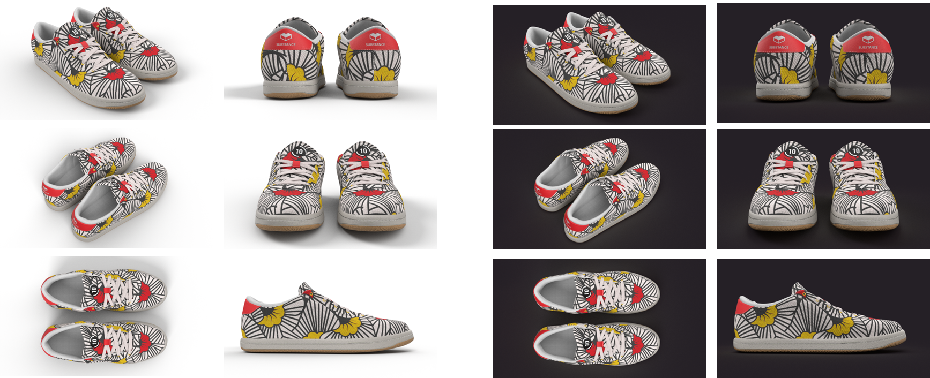
Example 3D use case : camera and background variations

Slide 14
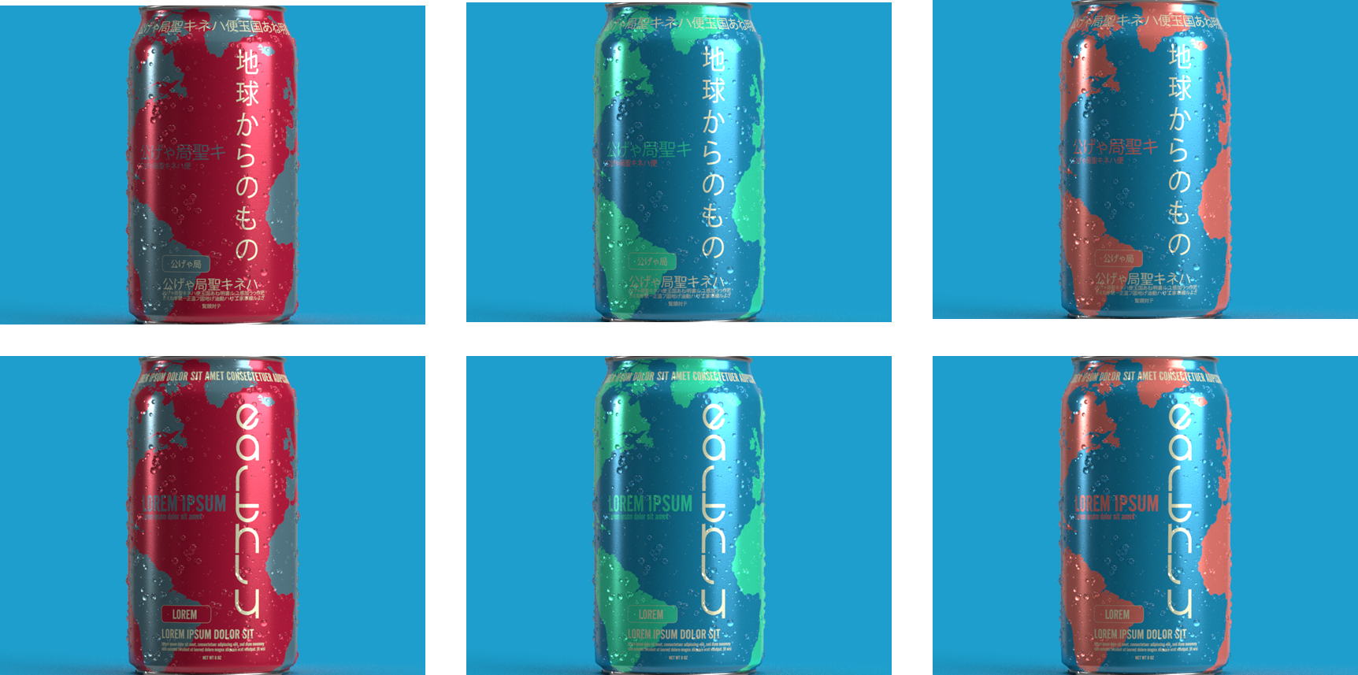
Example 3D use case: localizations and graphic variations

Slide 15
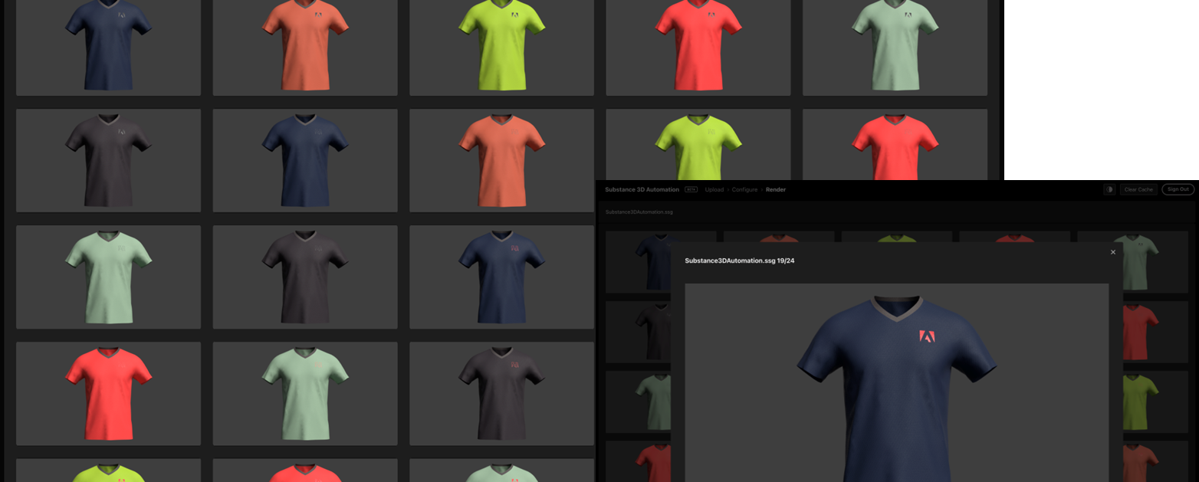
Example 3D use case: colorway and decal variation

Slide 16
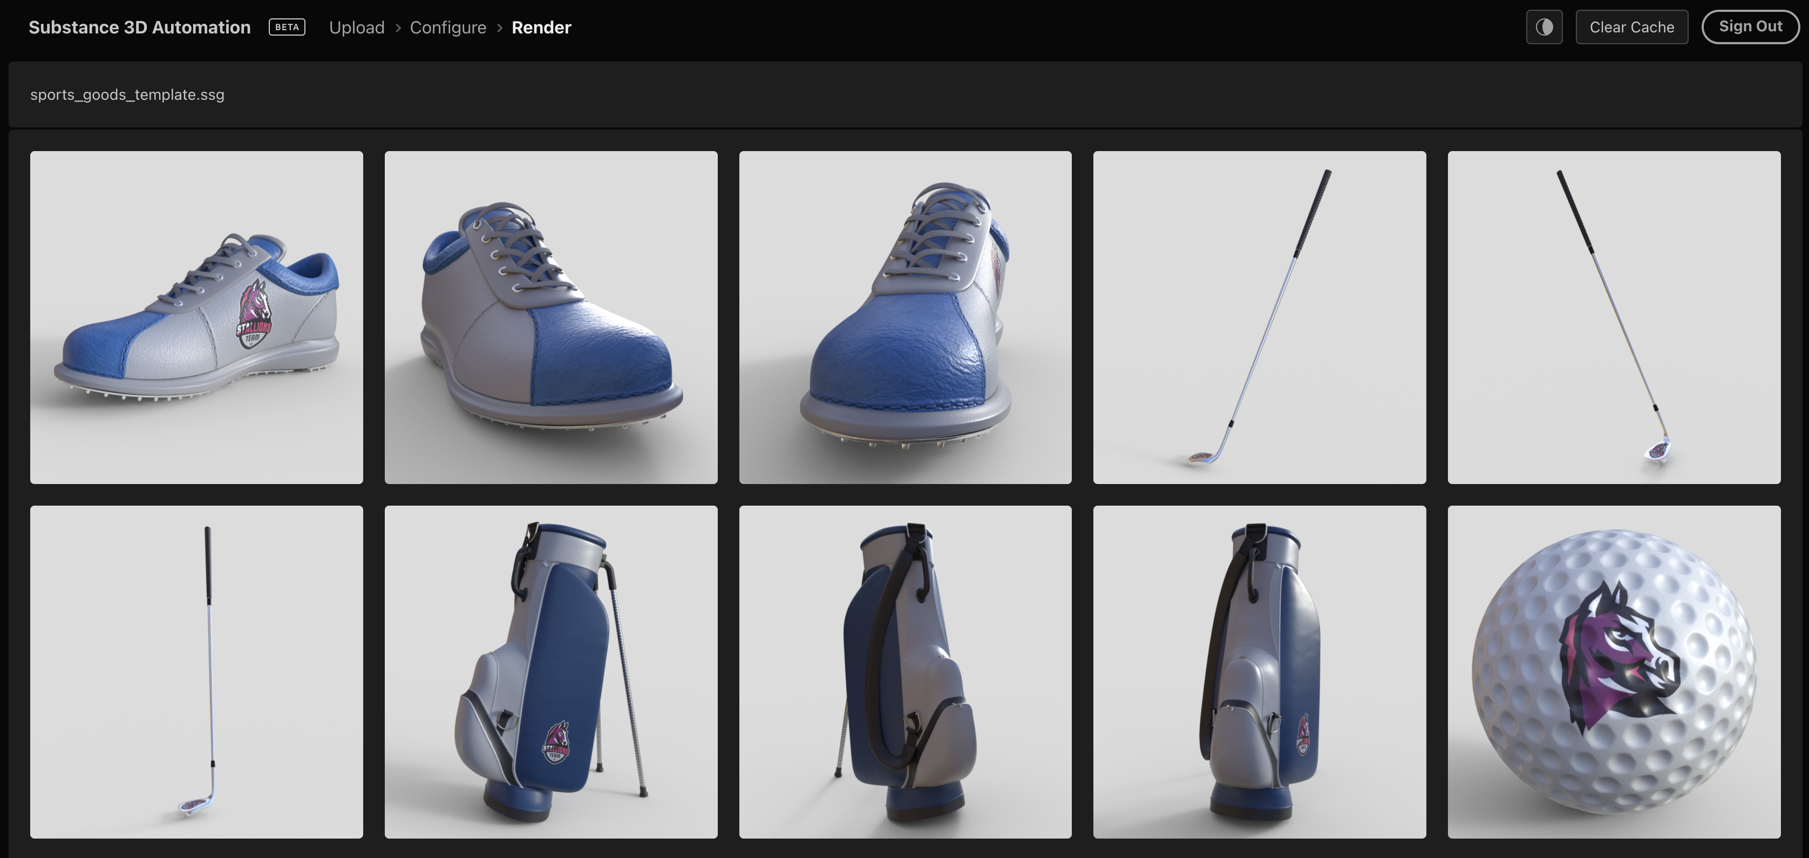
Example 3D use case: object replacement in a scene

Slide 17
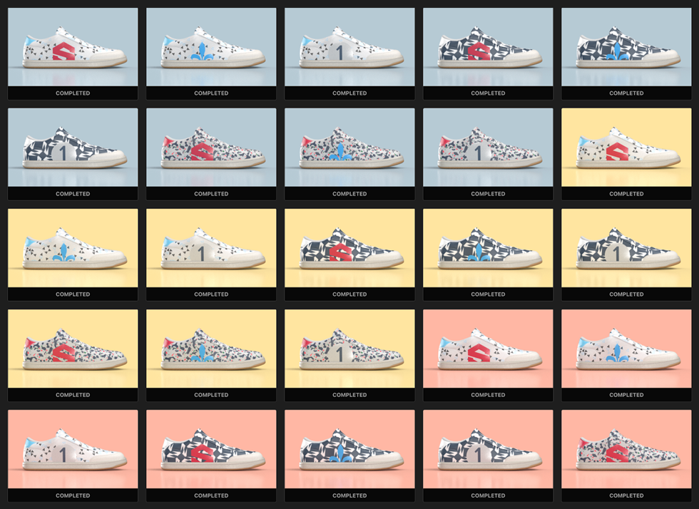
3D Automation Operations
Operations supported :
Replace 2D background
Replace material
Replace material texture or color
Replace decal
Replace object
Render multiple camera angles
Export to 3D file format

Slide 18
3D Automation Web Application

Slide 19
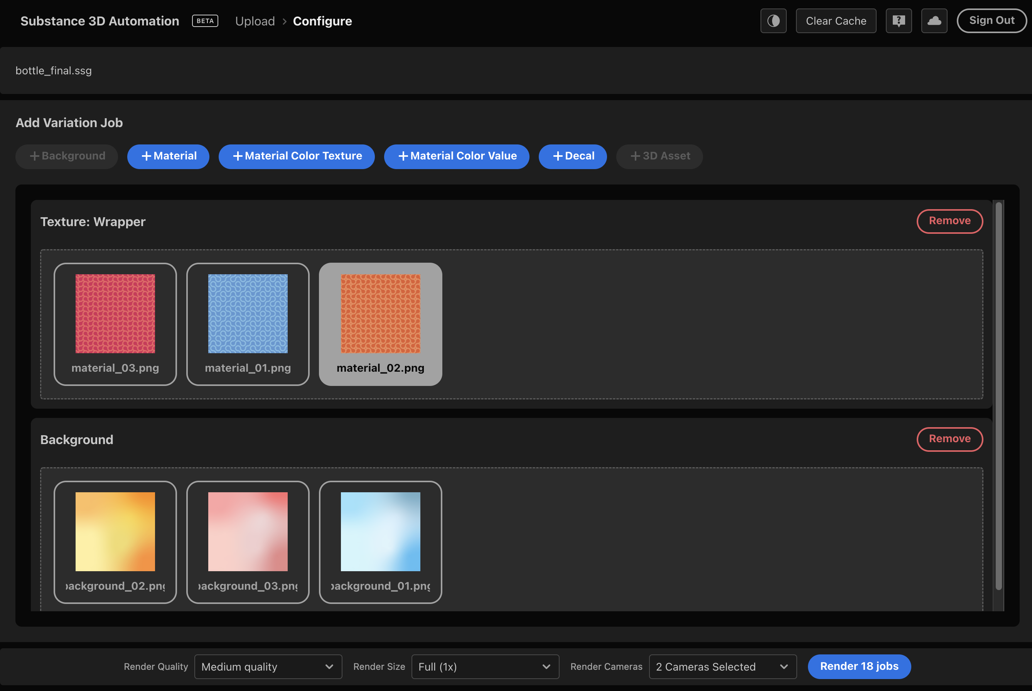
3D Automation web app
Intuitive user interface

Slide 20
3D Automation Service: Summary of Advantages
3D Automation Service
Integration made easy with our robust API
Pre-configured manipulations and operations
All orchestration, dynamic scaling and management of jobs taken care of
Fair share of compute resources guaranteed
No development or maintenance cost
All technology component upgrades are seamless
Adobe enterprise-grade security
Data privacy guaranteed
Adobe enterprise-grade reliability

Slide 21
Appendix

Slide 22
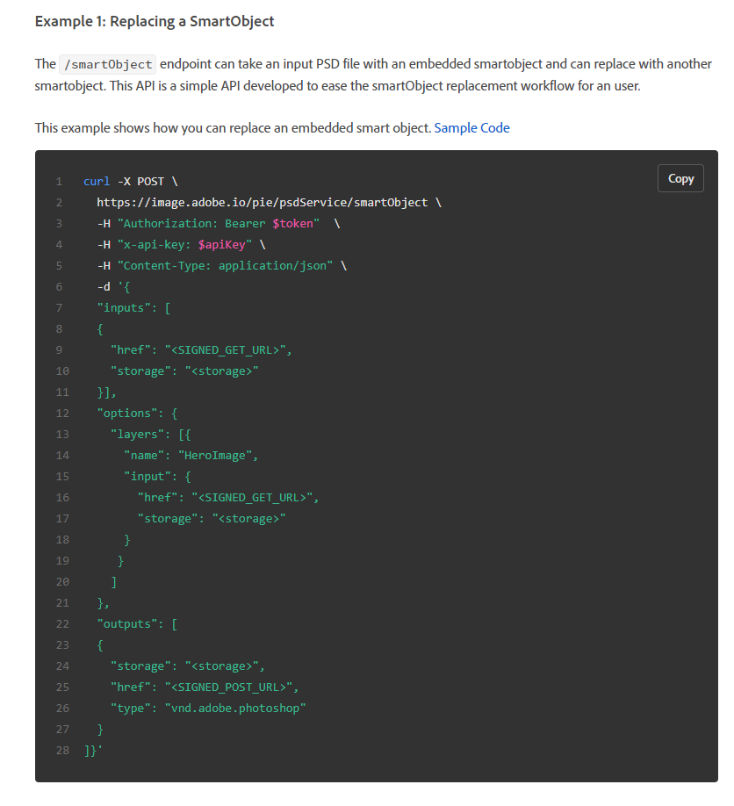
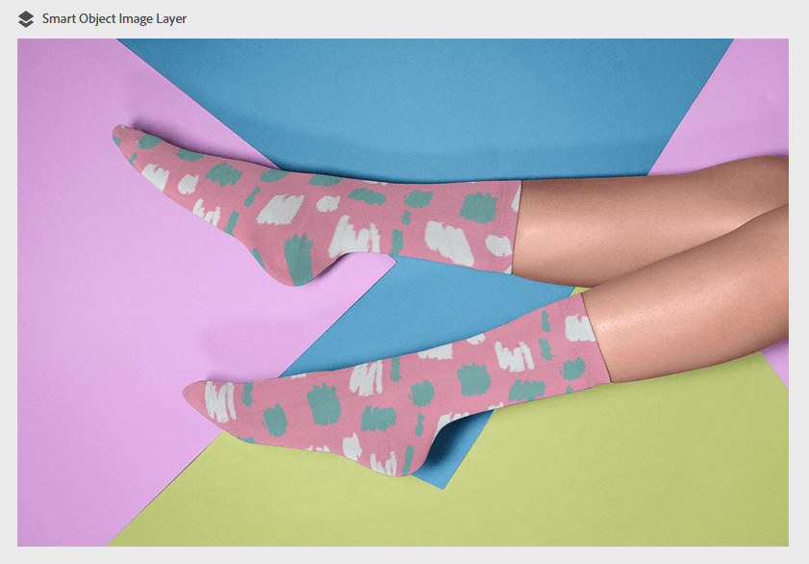

Slide 23
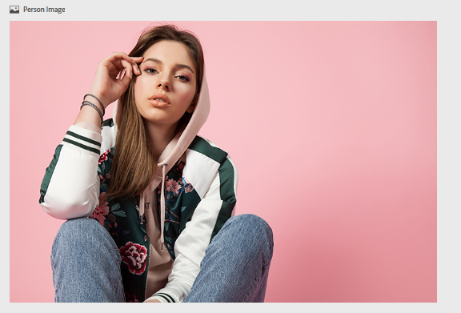
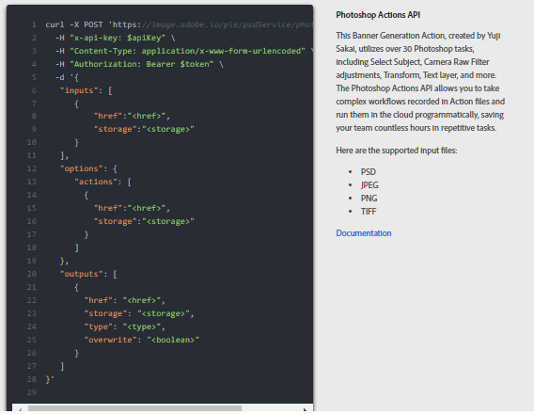

Notes:
https://app.frame.io/presentations/574fd2e5-be34-48ad-8314-f2cd534d4eee

Slide 24
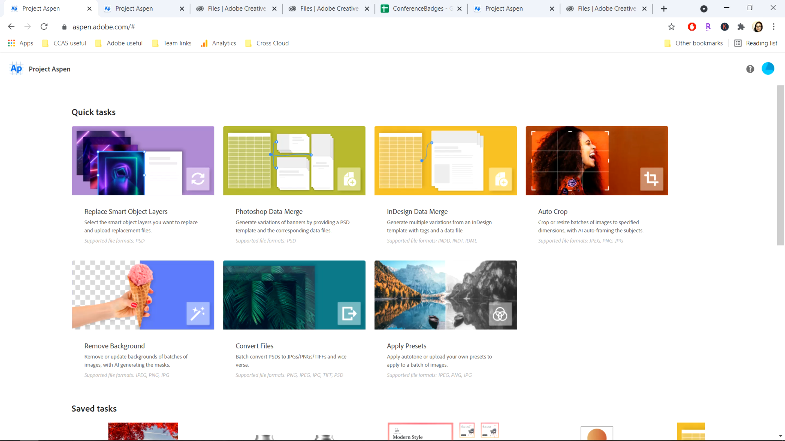

Slide 25
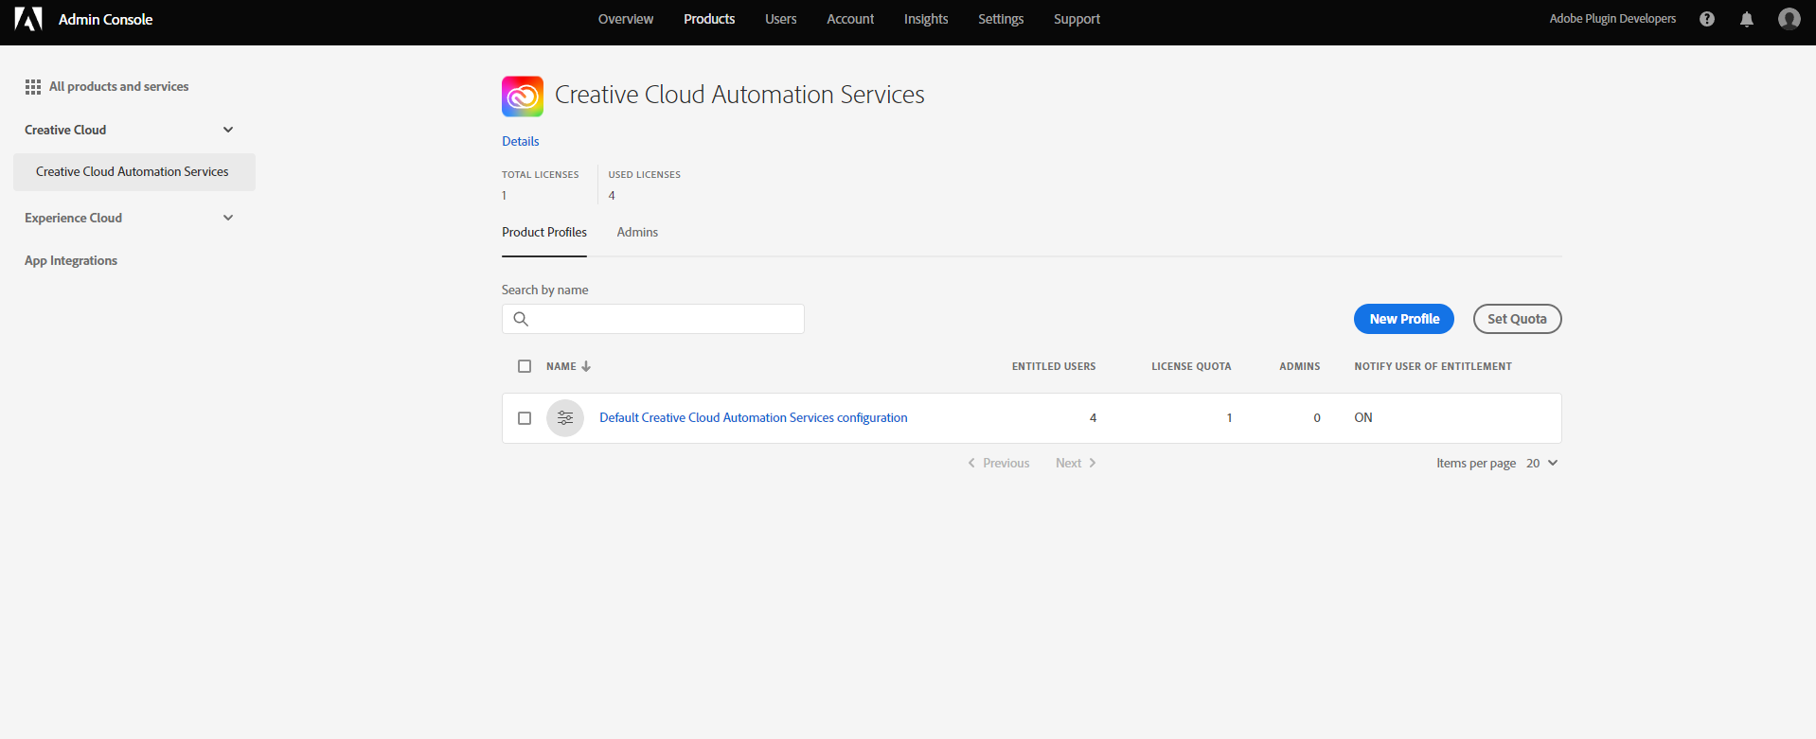

Slide 26
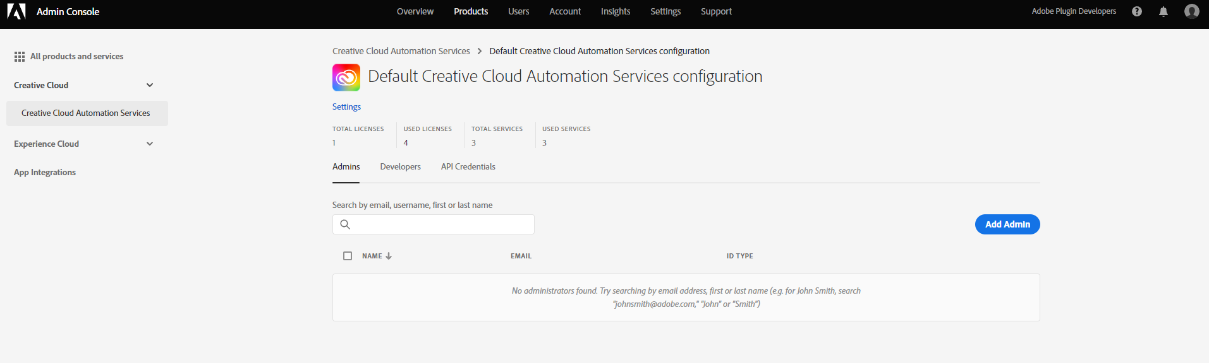

Slide 27
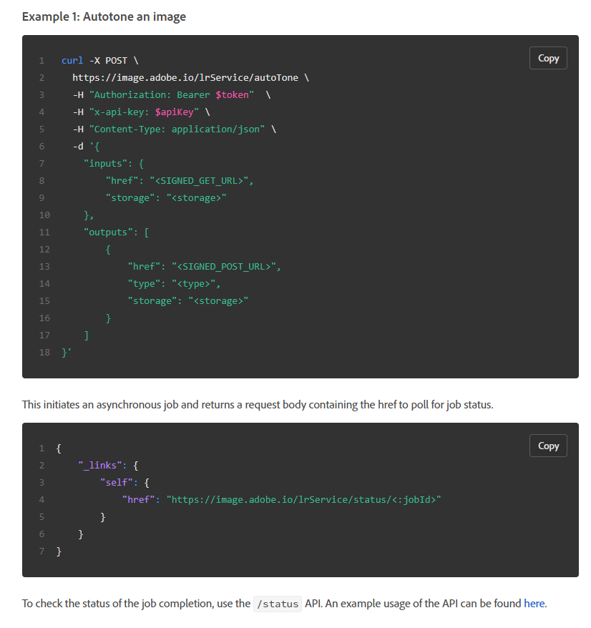
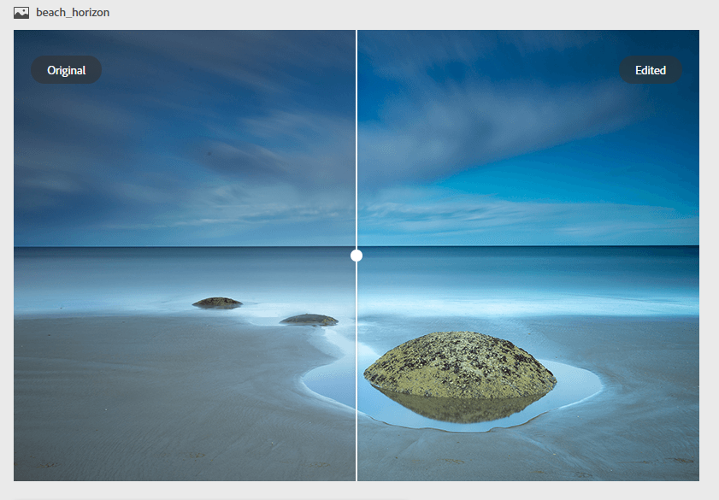

Slide 28
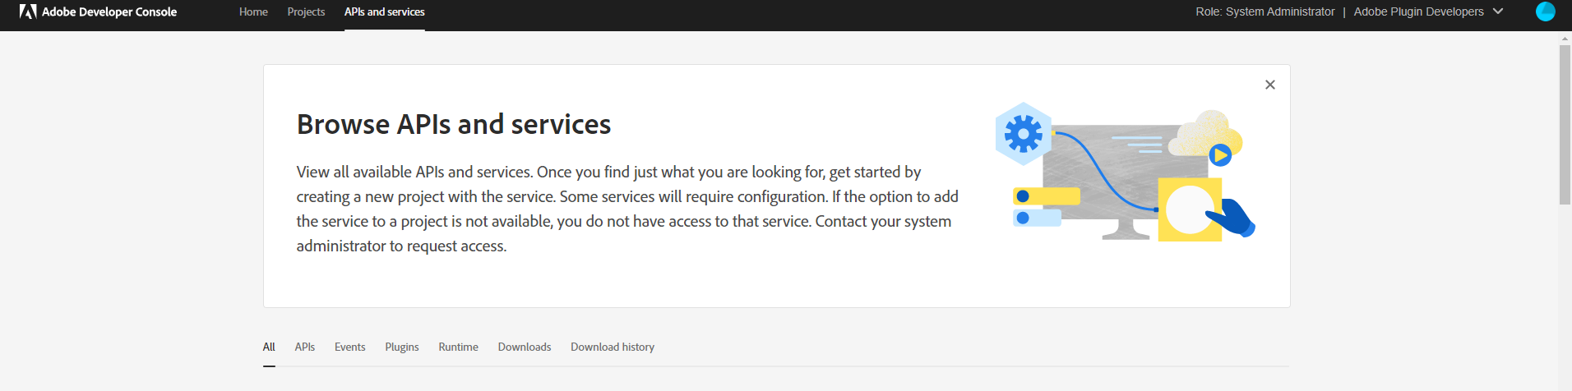
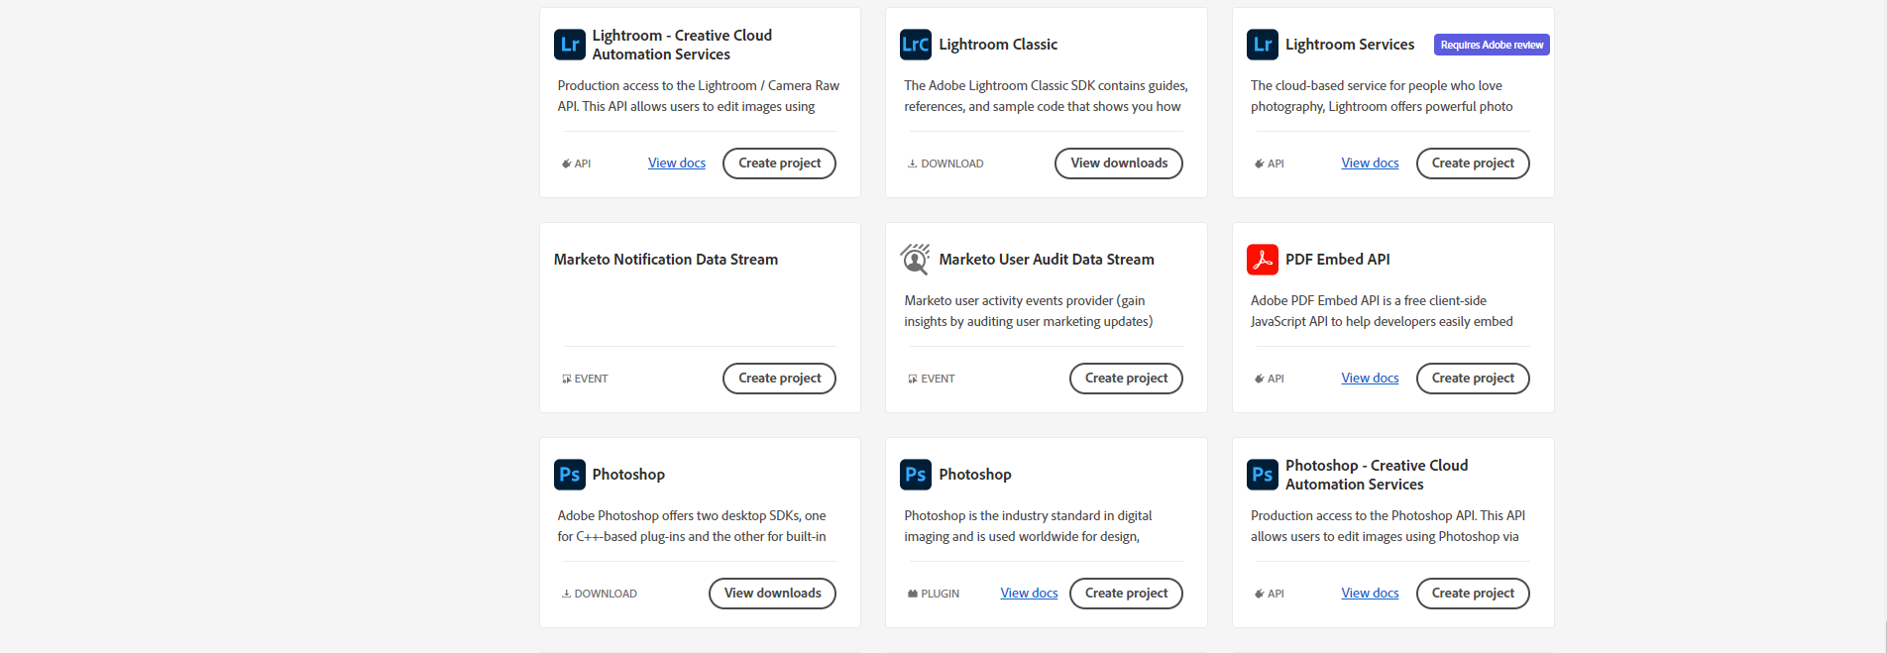

Slide 29
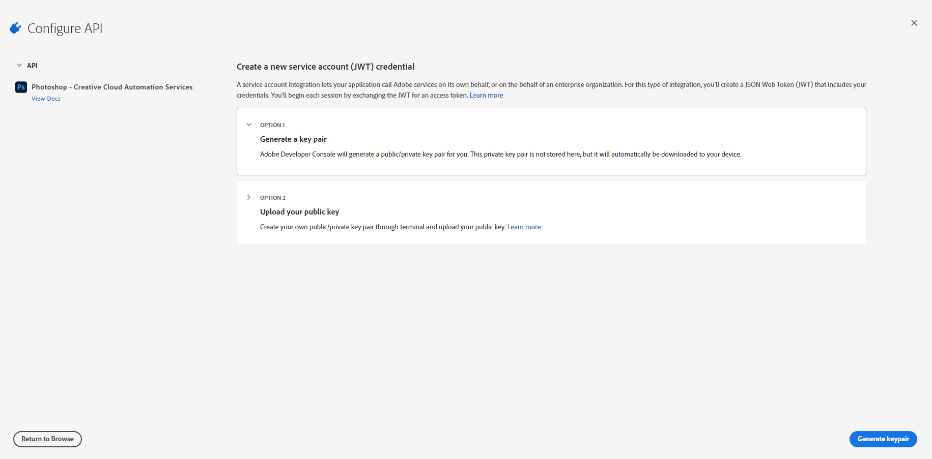

Slide 30
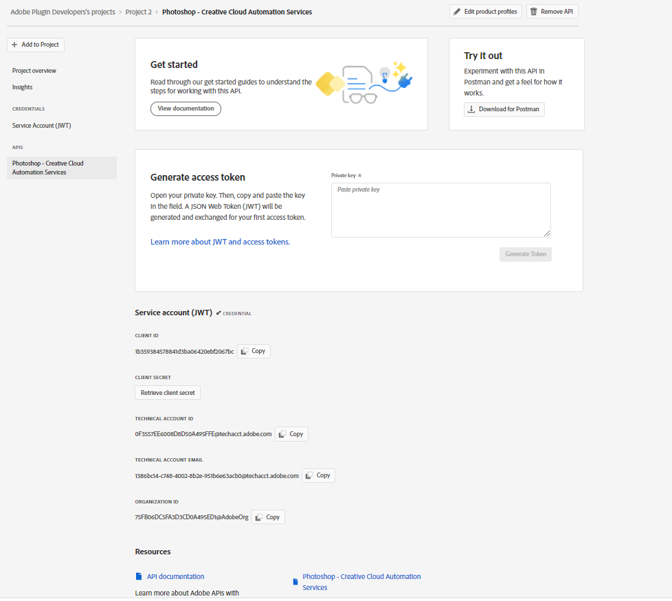

Slide 31
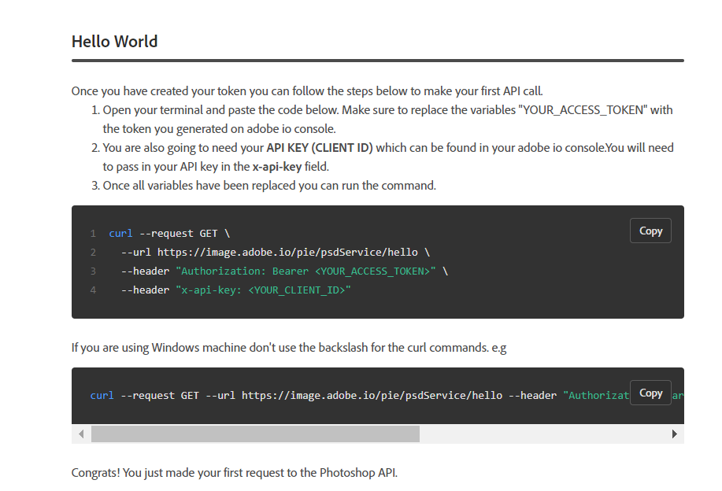

Slide 32
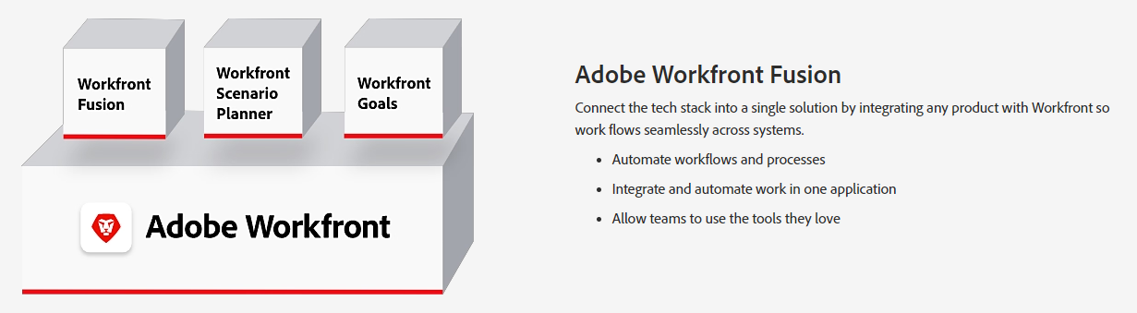

Slide 33
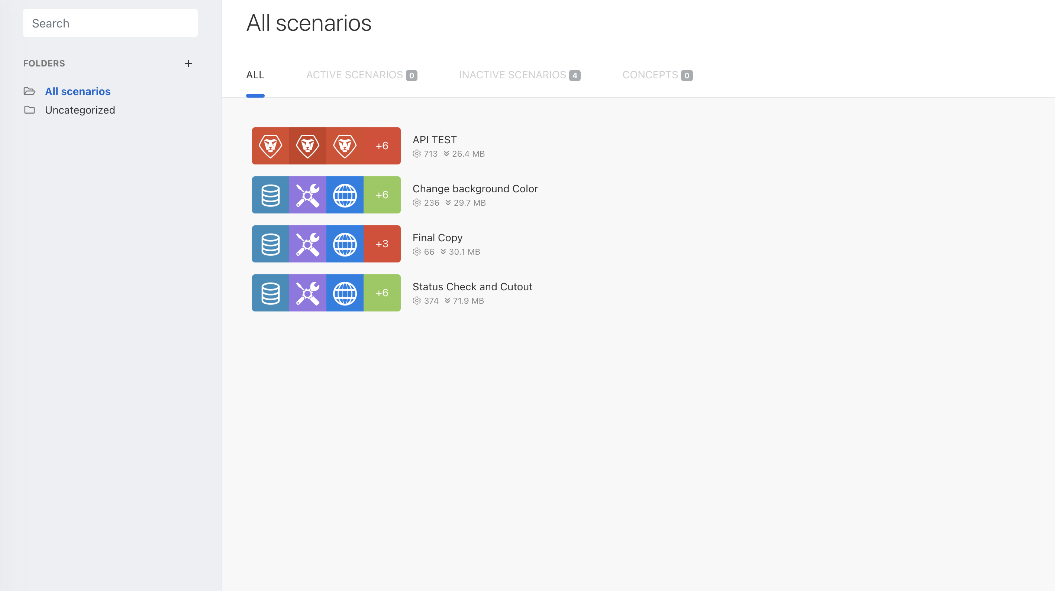

Slide 34



20+ functions are available across Adobe applications, with more to come
Verb
Use case
Value proposition
1
Photoshop Actions | Run actions on the server or in the cloud | Customers can create their own custom actions and execute server side or in the cloud
File conversion | PSD → TIFF, JPEG, PNG (and vice versa) | Convert one file type into another
Smart Object | Add or replace SmartObjects | Personalization: t-shirts with sports logos, etc.
Image cutout | Automatically detect and select people, objects, etc. | Mask and isolate a subject of interest in an image
Remove background | Automatically detect and remove background as layer | Similar to above, with an added step of removing the background
Image adjustments | Edit slider controls: exposure, brightness, etc. | Server-side adjustments for individual Adobe Camera Raw sliders
Layers | Add, fill, replace, toggle on/off, etc. | Manage basic layer operations: add, edit, reorder, etc.
Text | Add, edit, replace text, change fonts, etc. | Manage basic text operations: ideal for localization where text is replaced in multiple languages
Shapes | Add or resize shape layers | Manage basic shape operations
Art boards | Create new or extract manifest info | Automate art board creation for new PSDs
Banner ad reflow | Create banner ad variations from single input PSD | Automate banner ad creation tedium via Adobe Sensei
Retrieve manifest info | Extract manifest info | Inspect the contents of the PSD file
Manual crop image | Create new cropped rendition as PSD or other image format | Manually adjust visible portion of image
Renditions | Create thumbnails, resize, etc. | Create multiple thumbnails/versions at different sizes/resolutions
AutoTone | Adobe Sensei-based correction of all ACR slider values | One-button auto to "fix" bad photos
Presets | Apply any Lightroom-based preset to images at scale | Make all images B&W, vignette, pop color, etc.
Auto upright | Adobe Sensei-based geometry correction | Automatically straighten crooked or poorly proportioned photos
Lightroom edits | Making individual changes to standard Lightroom settings | Change exposure, dehaze, saturation or any single granular correction
Renditions | Create thumbnails, resize, etc. in jpg/png/pdf formats | Create multiple thumbnails/versions at different sizes/resolutions
Data Merge | Variable asset generation at scale using tagged InDesign files | Create multiple assets using variable fields in tagged InDesign files; ideal for personalization of assets at scale
2
3
4
5
6
7
Photoshop API
8
9
10
11
12
13
14
1
2
Photoshop Lightroom
API
3
4
1
2
InDesign API

Slide 35


